Slide 1
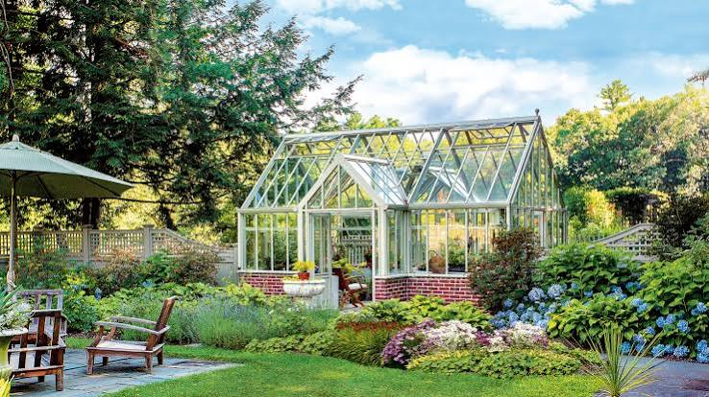
Greenhouse Climate Control System
ATmega32 (AVR) · Embedded C · Layered HAL / MCAL Architecture
Automated monitoring and control of temperature and soil moisture for a small-scale greenhouse.
Team 4 Sama Mohamed Mahmoud · Aseel Muhammed Elsayed · Khaled Mohamed Ahmed · Mohamed Sedeek Mohamed

Slide 2


Project Overview
The Greenhouse Climate Control System keeps growing conditions inside a small greenhouse within a healthy range — without a person having to watch it constantly.
It continuously reads air temperature and soil moisture, then drives a fan, heater, and water pump to correct conditions — either fully on its own in Automatic Mode, or switched directly on and off by the grower in Manual Mode.
Why it matters
Plants need a stable microclimate. Manual monitoring is slow to react and easy to neglect — automation keeps temperature and moisture in range around the clock, and warns the grower before conditions become critical.
2
Sensors monitored
(Temperature & Soil Moisture)
3
Actuators controlled
(Fan, Heater, Water Pump)
2
Operating modes
(Manual & Automatic)

Slide 3
Layered System Architecture )Software Structure(
APP
Application Layer : contains the project behavior and user interaction: main.c and Climate_Logic.c
HAL
Hardware Abstraction Layer : controls external modules such as LCD, Keypad, Sensors, Relay and Buzzer
MCAL
Microcontroller Abstraction Layer: controls low-level peripherals: DIO, ADC, Timer0, Timer1 and Global Interrupt
Each layer uses functions from the layer below it instead of directly handling hardware registers everywhere.
Commen/ (DEFINITIONS.h, BIT_MATH.h) provides shared types and bit-manipulation macros used across all three layers.

Slide 4







Hardware Components
ATmega32 (AVR) Microcontroller
Running at 8 MHz — coordinates all sensors, actuators, and the UI
LM35 Temp. Sensor
10 mV / °C, read via ADC0
Soil Moisture Sensor
Analog probe, read via ADC1
Relay Module ×3
Drives fan, heater & pump
16×2 LCD
Live readings & system status
4×4 Keypad
Mode select & manual input
Buzzer
Critical alarm indicator

Slide 5



Three Operating Modes Selected on-device via the keypad menu; switching modes always stops all actuators first.
Manual
The grower directly switches the pump, fan, and heater on or off from the keypad; the automatic control logic does not run in this mode.
Standby
Default state on power-up. All actuators are off and no control logic runs.
Automatic
The system controls the fan, heater, and pump using temperature and moisture thresholds, reconfigurable from the keypad.

Slide 6
Temperature Control Logic Automatic mode uses hysteresis so the fan and heater don't rapidly switch on and off near a threshold.
10°C
Critical Low
18°C
Heater ON
20°C
Heater OFF
38°C
Fan OFF
40°C
Fan ON
50°C
Critical High
Critical alarm
Heater active
Comfortable range
Fan active
Manual mode
There is no threshold logic here — the grower switches the fan and heater on/off directly from the keypad. The two are interlocked: turning one on always switches the other off.

Slide 7
Soil Moisture Control Logic The water pump follows the same hysteresis principle: it turns on at the dry threshold and off once moisture recovers past it.
10%
Critical Dry
35%
Pump ON
40%
Pump OFF
Critical alarm (< 10%)
Pump active (dry)
Sufficiently moist
Manual mode
the grower turns the pump directly on or off from the keypad, independent of the moisture reading.

Slide 8


Safety & Fail-Safe Features Three independent safeguards protect the hardware and the crop, active in both operating modes.
Fan / Heater Interlock
Critical Alarm
Sensor Error Handling
The fan and heater can never run at the same time — switching one on always switches the other off first, in both operating modes.
Buzzer triggers instantly if temperature ≥ 50°C, ≤ 10°C, or moisture ≤ 10%, in either Manual or Automatic mode.
An out-of-range reading shuts off the fan, heater & pump, sounds the buzzer, and reports a SENSOR ERROR state.

Slide 9

Main Control Loop
Read temperature
& soil moisture
Validate sensor
ranges
Apply mode logic
(Manual / Automatic)
Update fan, heater
& pump outputs
Check alarm &
update LCD
Loop repeats continuously — sensors are sampled every 500 ms.
If a sensor reading is invalid: the loop skips mode logic entirely and calls the sensor-error handler — all actuators off, buzzer on — until a valid reading returns.

Slide 10
User Interface
A 16×2 LCD and 4×4 keypad let the grower monitor and configure the system on-device.
LCD DISPLAY (16×2)
4×4 KEYPAD LAYOUT
7
8
9
/
MAN P:0 F:1 H:0
4
5
6
*
1:P 2:F 3:H =:S
1
2
3
-
C
0
=
+
Manual-mode screen — current actuator states (Pump/Fan/Heater) and available keys
Digits enter values; C cancels/backs out; = confirms an entry
Screen flow: Mode Menu → Manual / Automatic Screen → Config Menu (Min/Max Temp, Min Moisture) → back to previous screen

Slide 11

Project Goal
Build a simple, reliable automated greenhouse system that monitors temperature and soil moisture, and controls the fan, heater, and pump to maintain suitable growing conditions — with safety limits that protect the hardware and alert the grower.
TEAM 4
Sama Mohamed Mahmoud
Aseel Muhammed Elsayed
Khaled Mohamed Ahmed
Mohamed Sedeek Mohamed
Thank you

